Slide 1
Sirius Type-C Review
Jinfeng.Huang
2017/11/30

Slide 2
Agenda
TypeC Introduction
IP introduction
PCB Solution
Mode of operation
Local simu
SoC simu
Package
ATE test
Synthesis

Slide 3
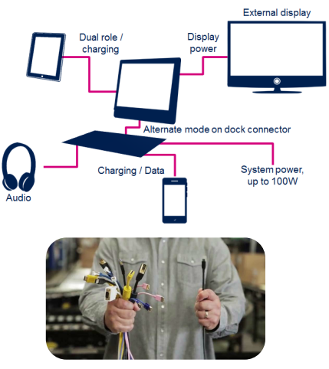
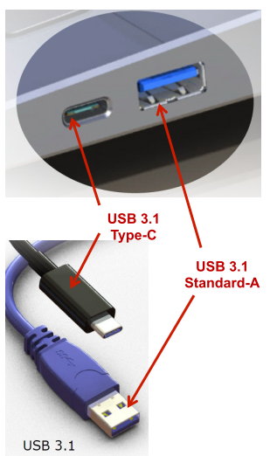

TypeC Introduction 1
USB Type-C Standard
USB2.0
USB3.1 Gen1(5Gbps)/Gen2(10Gbps)
USB Power Delivery(PD) Standard
Scalable power charging (up to 100W)
USB Type-C Alternate Mode Standard
Displayport
HDMI
Thunderbolt
...

Slide 4
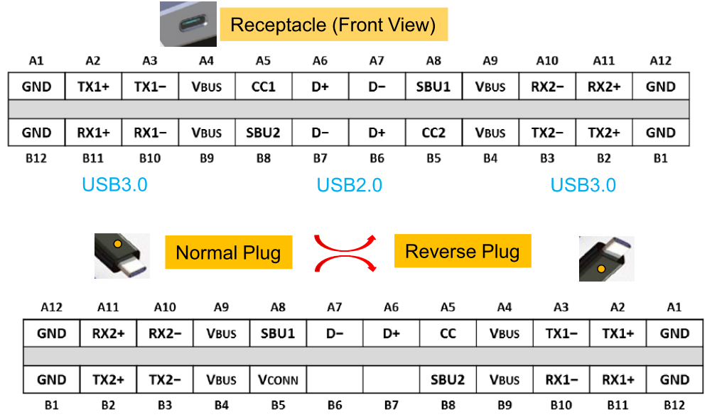
TypeC Introduction 2
USB Type-C Connector - Pinout and Alignment

Slide 5
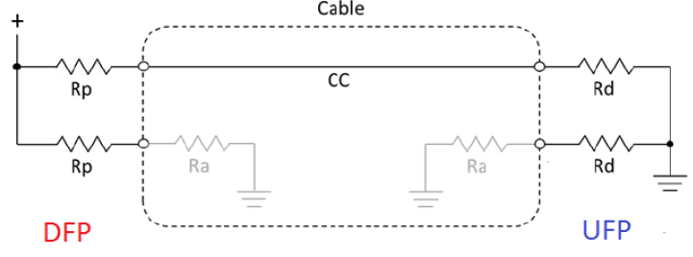
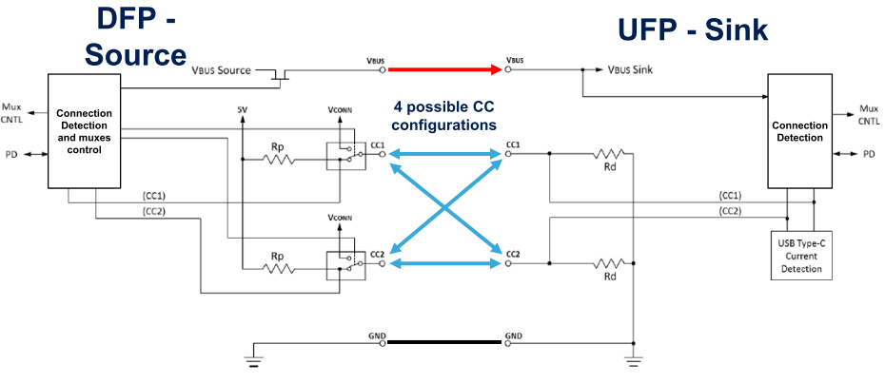
TypeC Introduction 3
Attach/Detach detection
Determination Plug orientation
Establish DFP and UFP roles
Current Rating (Discover and configure Vbus）
Repurpose as Vconn
USB PD Communication (BMC)

Slide 6
IP Introduction 1
USB3.0 DRD
PIPE 16/32-bit interface
Host--Maximum of 64 slot, 32 endpoints per slot
Device--Max 16 endpoints, Rx/Tx MaxPacket Size 1024 Byte
DP1.2 TX
lane and clock: 4 lanes, 5.4Gbps
Color depth and format： 8/10/12/16
Video format: RGB/YUV444/YUV422/YUV420
CSC: RGB<-->YUV, YUV444<-->YUV422
I2S audio interface, i2s_data[4]
HDCPv1.4 and HDCPv2.2 Authentication and Encryption
PD v2.0
3 current modes
Alternate mode
DRP support

Slide 7
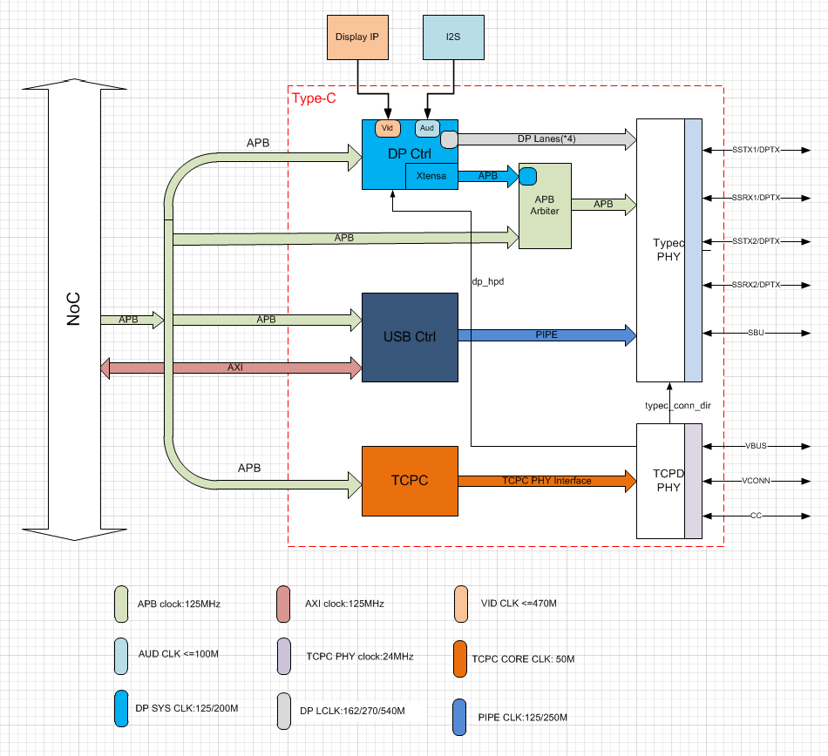
IP Introduction 2

Slide 8
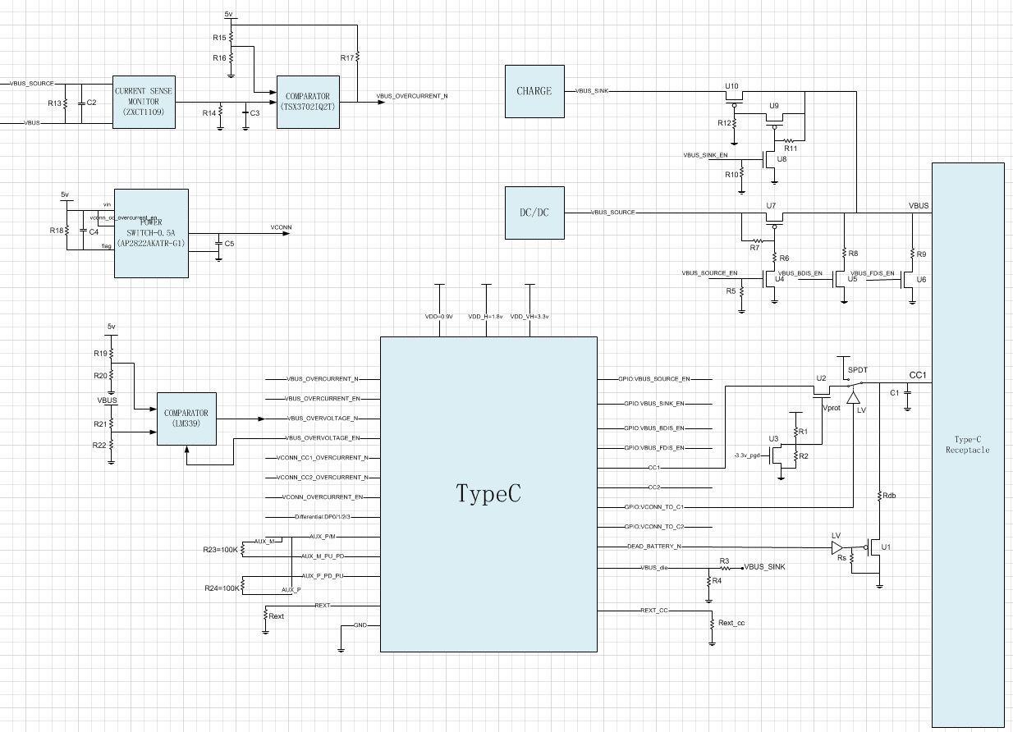
PCB Solution

Slide 9
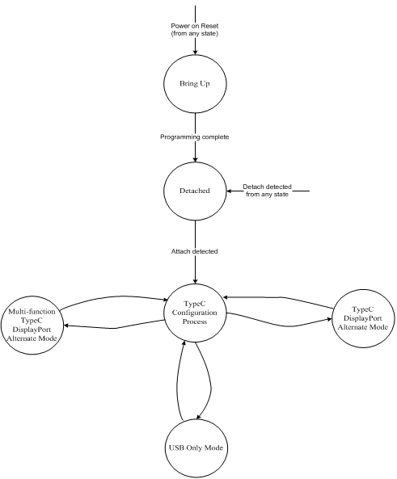
Mode of operation
TCPC mode:
strap pin: DFP/UFP/DRP
USB mode:
mode_strap: Host/Device

Slide 10
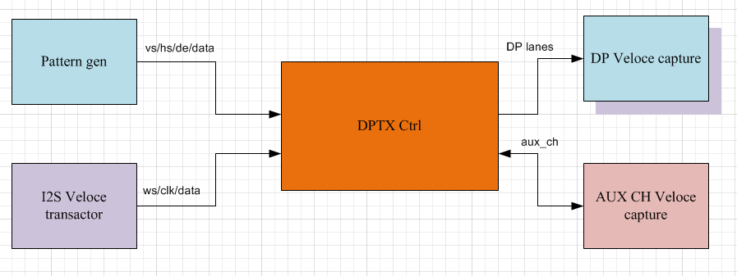
Local sim 1

Slide 11
Local sim 2

Slide 12
SoC sim
Connect two sirius testbench using typec link
Easy to replace rtl to netlist and run post sim

Slide 13
Package

Slide 14
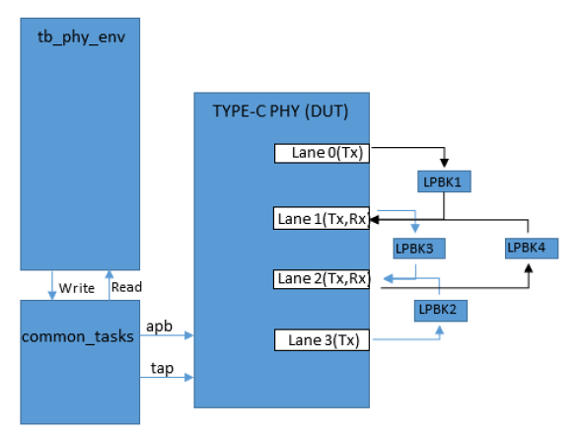
ATE Test
Loopback1 sequence: Lane0[TX0] --> Lane1[RX1]
Loopback2 sequence: Lane3[TX3] --> Lane2[RX2]
Loopback3 sequence: Lane1[TX1] --> Lane2[RX2]
Loopback4 sequence: Lane2[TX2] --> Lane1[RX1]

Slide 15
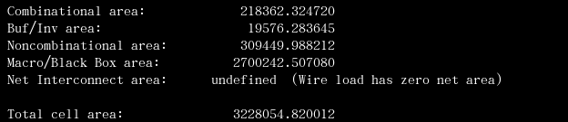
Synthesis Result
Integrate constraint of Controller & PHY
Macro/Black Box area
PHY + MEM
2.07 + 0.63

Slide 16
Thanks. Q&A

